Slide 1
Generalized Streaming Data Architecture
Pravin Y Pawar

Slide 2
Streaming Data Systems
Defined again
… are layered systems that rely on several loosely coupled systems
Helps in achieving high availability
Helps in managing the system
Helps in maintaining the cost under control
All subsystems / components can reside on individual physical servers or can be co hosted on the single or more than one servers
Not all components to be present in every system
Contents adapted from Real-Time Analytics , Byron Ellis

Slide 3
Streaming Data System Components
Streaming Data System Architecture Components
Collection
Data Flow
Processing
Storage
Delivery

Slide 4
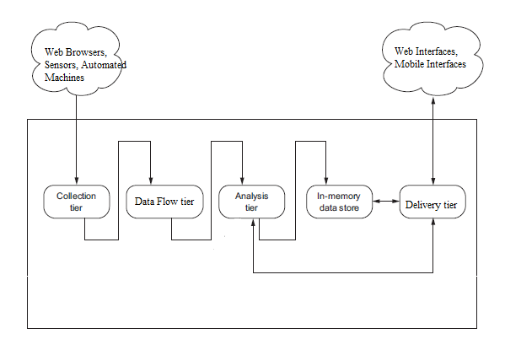
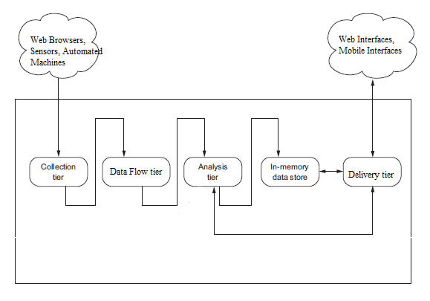
Generalized Architecture
Altered version, original concept : Andrew G. Psaltis

Slide 5
Architecture Components (1)
Collection System
Mostly communication over TCP/IP network using HTTP
Websites log data was the initial days use case
W3C standard log data format was used
Newer formats like JSON, AVRO, Thrift are available now
Collection happens at specialized servers called edge servers
Collection process is usually application specific
New servers integrates directly with data flow systems
Old servers may or may not integrate directly with data flow systems

Slide 6
Architecture Components (2)
Data Flow Tier
Separation between collection tier and processing layer is required
Rates at which these systems works are different
What if one of system is not able to cope with another system?
Required intermediate layer that takes responsibility of
accepting messages / events from collection layer
providing those messages / events to processing layer
Real time interface to data layer for both producers and consumers of data
Helps in guaranteeing the “at least once” semantics

Slide 7
Architecture Components (3)
Processing / Analytics Tier
Based on “data locality” principle
Move the software / code to a the location of data
Rely on distributed processing of data
Framework does the most of the heavy lifting of data partitioning, job scheduling, job managing
Available Frameworks
Apache Storm
Apache Spark (Streaming)
Apache Kafka Streaming etc

Slide 8
Architecture Components (4)
Storage Tier
In memory or permanent
Usually in memory as data is processed once
But can have use cases where events / outcomes needs to be persisted as well
NoSQL databases becoming popular choice for permanent storage
MongoDB
Cassandra
But usage varies as per the use case, still no database that fits all use cases

Slide 9
Architecture Components (5)
Delivery Layer
Usually web based interface
Now a days mobile interfaces are becoming quite popular
Dashboards are built with streaming visualizations that gets continuously updated as underlying events are processed
HTML + CSS + Java script + Websockets can be used to create interfaces and update them
HTML5 elements can be used to render interfaces
SVG, PDF formats used to render the outcomes
Monitoring / Alerting Use cases
Feeding data to downstream applications

Slide 10
Thank You!
In our next session: Lambda Architecture

